Slide 1

Transition Coach – Practice Principles
Developed through our co-design work with
the Youth Advisory group and guided by the feedback from the young people and families participating in the trial.
These principles provide Transition Coaches with a set of easy-to-follow
references for how they should approach
their work with young people.

Slide 2
A RELIABLE SOURCE OF SUPPORT IS YOUR RIGHT
It's your choice to join and you can choose to come and go.

Slide 3



  This means:
Your Coach is a reliable source of support and someone you can speak to directly about your choices.
You can access a range of financial supports directly through your Coach and the Home Stretch WA team, someone who knows you and what you are trying to achieve. ​
​
Home Stretch WA support is flexible, and responsive, it adapts to meet your needs.
It is your choice to access Home Stretch WA, and you can Opt-out at any time.
  Home Stretch WA support includes a focus on investing in you and your future, funding to help with your goals and to deal with emergencies.
  It also includes a Housing Allowance that can financially help you to Stay On with a foster carer, or to help you find a stable and safe place to live.
  We will teach you about your rights, and the range of resources available to you beyond the Child Protection system. You will build the skills and knowledge you need to access them after 21.​

Slide 4
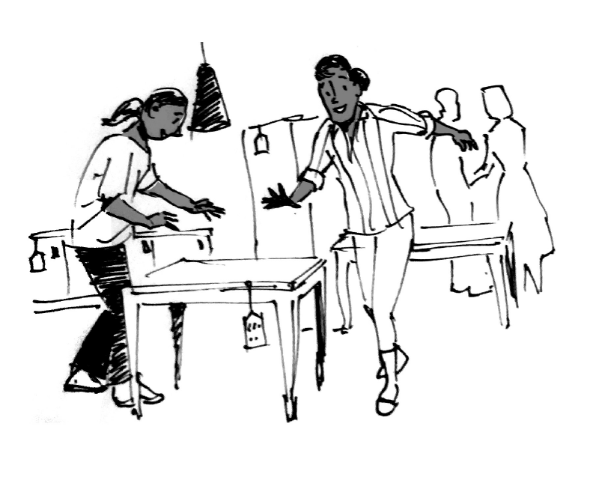
You are the expert in your life, you deserve the freedom and respect to make your own choices
Our support is unconditional

Slide 5
  This means:
We will listen to you and be
guided by what you say, and
how you want to be supported.
We know it takes time to earn
your trust. We will be reliable
and stick around for as long as
it takes.​
​
Your coach will look for the
strengths within and around you,
and help you find opportunities
to test yourself and grow.
Failure and bad choices are learning opportunities. We will encourage
you to try and test new things, to
learn by doing and to create your
own path.​
​
We will be a safety net to help when things go wrong, helping you to find a way forwards no matter what has happened.​
You have the right to complain, and have your concerns taken seriously and responded to by Home Stretch WA.
You have the right to make complaints about Home Stretch WA to people who don’t work for Home Stretch WA. This includes the Child Advocate and the Department for Child Protection.

Slide 6
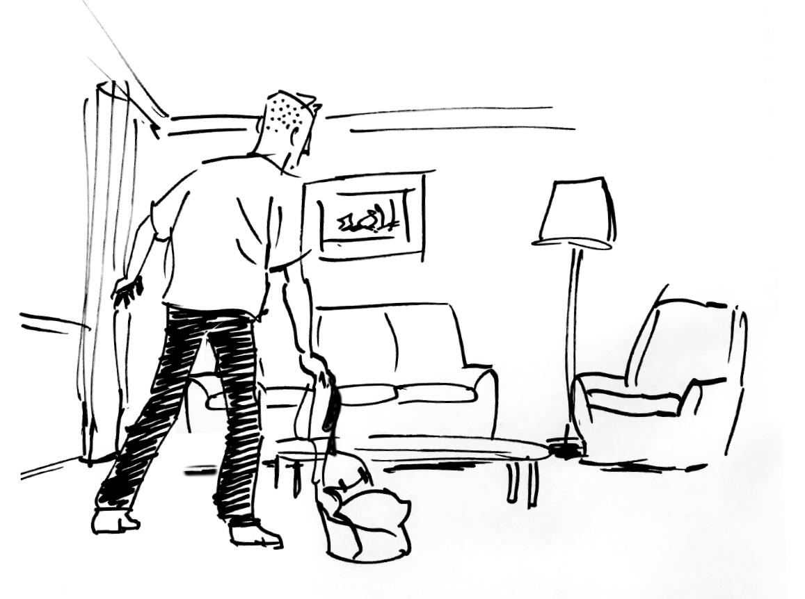
"Chipping In" is about
young people taking charge
This means that young people are asked to invest in themselves - building their skills, knowledge and capacity

Slide 7
  This means:
We want you to take charge of your life, to be smart with your money. We also want to invest in you and make sure you have the things you need to succeed.
We will make sure you have an income and help you to become financially independent over time. ​
​
We will ask you to ‘Chip In’ whenever you access financial support through Home Stretch WA. ​
​
Sometimes that will mean putting your own money towards your
expenses and Home Stretch WA
providing the rest.​
​
Other times it will be about you putting in time and effort to build your skills, knowledge and experience. Every person and situation is unique.
​
In times of crisis and emergency, it may be about dealing with the problem first and then working out what you might do differently next time.​
You have the right to challenge decisions you think are unfair, we will work through it together.

Slide 8
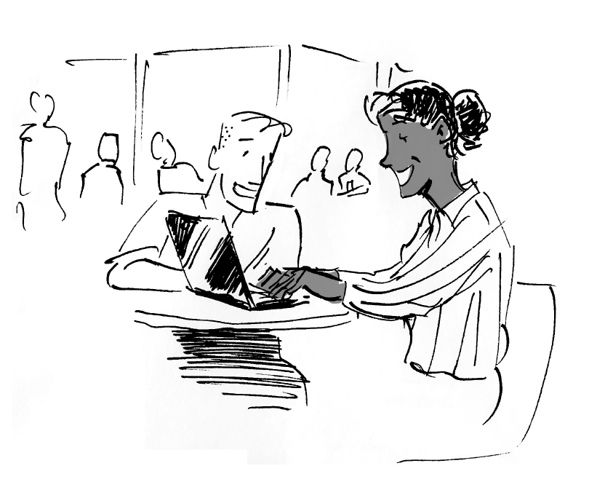
You can make an informed choice about the support you receive from Home Stretch WA
There are no shocks for you or the important people in your life

Slide 9
    This means:
You can watch a video, read a flyer
or talk to someone about how Home
Stretch WA works.
You will be given clear information about Home Stretch WA during your Leaving Care planning so you can understand your options & make a choice. There are other ways to be supported & no negative consequences if you change your mind.
You can choose to leave and then come back for support anytime before you turn 21.
You will have a chance to have your questions answered before you join Home Stretch WA.
Your Home Stretch WA Coach will be clear with you about their responsibilities, and your rights.
From 17 ½ to 18 we will work with the important people in your life so you can get to know us before you turn 18.
The option to extend your living arrangement will be discussed before you turn 17 so you have plenty of time to decide.

Slide 10
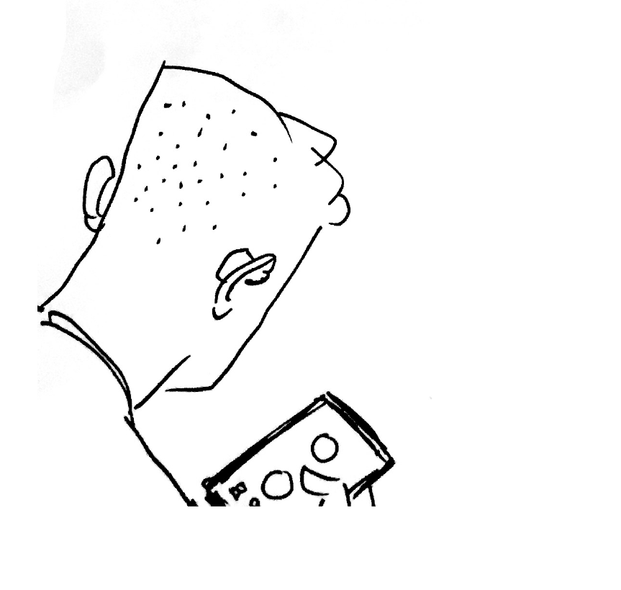
Your coach will be consistent & persistent
but not intrusive ​
“Like a text message, not a knock on the door”

Slide 11
  This means:
Consistent
Your Coach will follow through on things you have agreed they will do
Persistent
Your Coach will always let you know they are there, even if they haven't heard back from you. After 3 months of no contact, we might assume you have chosen to leave support.
Respectful
You agree on how you will be supported, how often and where.
Your Coach will support you in locations where you feel comfortable.
Your coach can check in with people you trust if you say it is ok. This may be family, carers, or other agencies.
If you say that it is ok for your coach to check in with trusted people, your coach will be transparent about any contact they make with others.
Support from your Coach is flexible
and can be adjusted depending on
your situation. We can offer more or
less support, depending on what is
happening in your life.

Slide 12
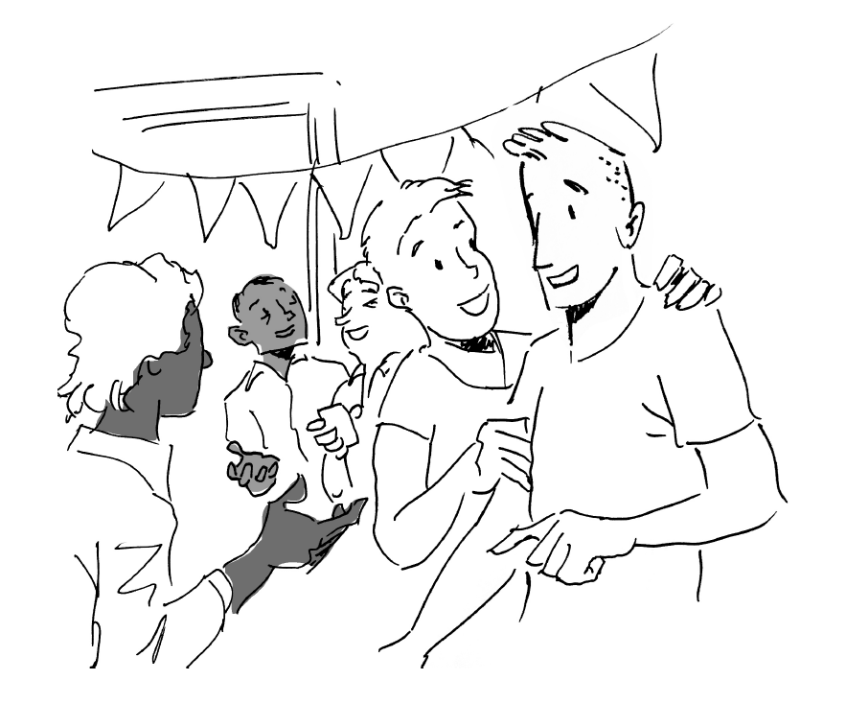
Important moments
& transition points in your life are acknowledged
& celebrated

Slide 13
  This means:
We understand that important moments and transition points can be different for each person, culture, family, and community.
Your coach will work with you to understand which moments are significant for you, including getting to know any cultural mile-stones which may be important to you.
Your coach will recognise and celebrate your growth and development. This includes growth in how you see yourself and how you are seen by your family and community.
We will support you to celebrate important moments with friends, family and other important people in your life.
Your coach will offer opportunities to celebrate important moments such as going on a camp or returning to country.
Your Coach will be mindful that what might be a milestone or celebration for some can be difficult for others.

Slide 14
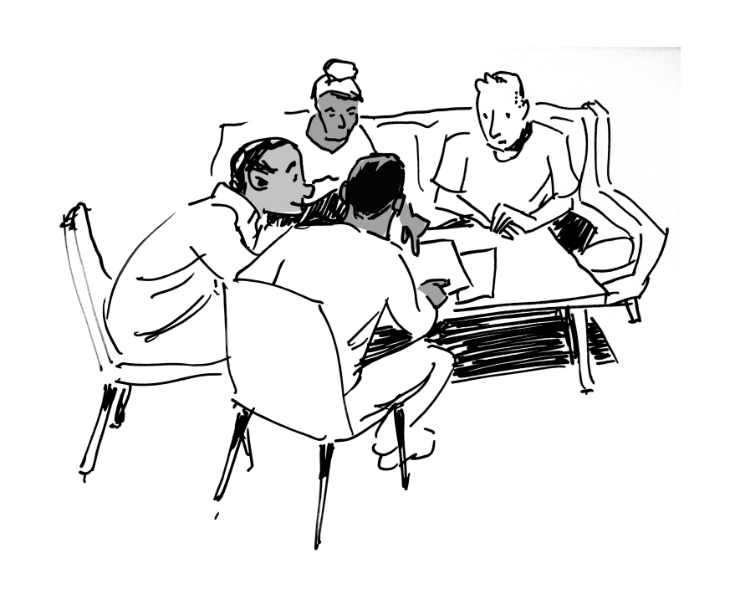
Your Relationships are important​
The important people in your life can be part
of your Home Stretch WA experience and we can support you to build new connections

Slide 15
  This means:
Your coach will learn about who and what is important to you. We will make sure they are part of your support circle.
Your coach can help you strengthen your relationships and find and build new connections.
If there are people that you don’t want in your life, we will respect this.
Your coach will support you to understand and develop boundaries that will help you stay strong and safe.
Your coach will work with your family and other important people in your life if you want them to. You decide their involvement, and you can include them in decision-making.
We will respect your family commitments and obligations, and the role you have in your family.
Your coach will work with you to find activities, groups, people and programs that will help you to feel supported and connected.

Slide 16
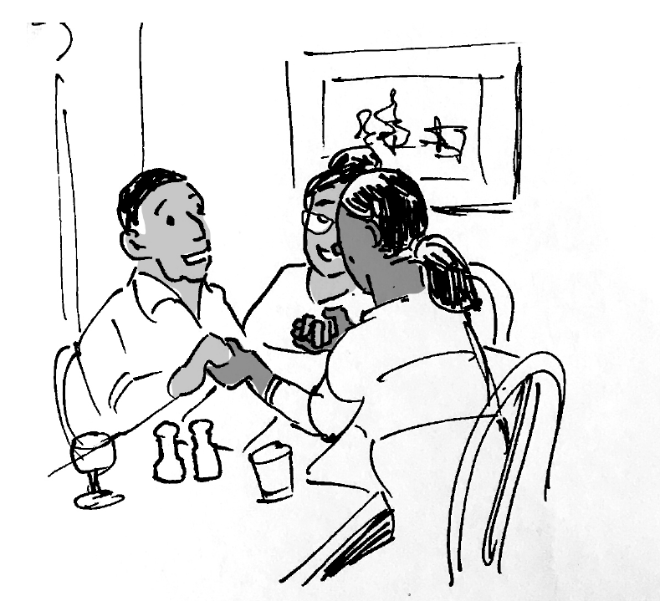
Culturally Safe
Home Stretch WA recognises Aboriginal and CALD young people must navigate between two worlds.

Slide 17
  This means:
We will make sure you have access to your story and help find the right people to help you understand your family, country, community and culture.
Coaches will be trained to understand how trauma impacts, racism and unconscious bias so that they can be aware.
Your coach is a shoulder for you to lean on. They will check in with you and help you be the best person you can be.
We recognise that Aboriginal and Torres Straight Islander people are the experts in providing
culturally responsive services to
Aboriginal families.
You will be given information that will help you choose which Agency will best support your needs.
You will have the option of the support of an Aboriginal Community led Agency.
Coaches will help you to understand how you move between and join your different worlds.

Slide 18

Know your mob
to know your place
When you’re ready we will help you find ways to build your connection
to family and culture.

Slide 19

This means:
Your mob represents your connection to land, family, identity, culture and community.
Your Coach will help you find out your story when you are ready to hear it.
They will walk alongside to help you understand and explore the people, places and connections that are important to you.​
Your Coach will offer to map out the connections and relationships that matter, building on the knowledge you have and the genograms and cultural plans that may have been made for you.
You will decide who in your birth family you want to connect with, how, when and where.
It is your choice to connect to your family and community. When you are ready your coach will help support you to build connections to people and places.
Your coach will support you in finding culturally safe organisations and programs.
​

Slide 20

Heal and Connect
When you are ready.

Slide 21

This means:
Your Coach will be trained in understanding the pain, grief, loss and trauma that can come from being taken into care.
Your Coach will be guided by you, what you want and what you are ready to explore. This includes exploring your family, history, culture, country and community.
Your Coach can support you to access programs and people who will build your knowledge of culture and community.
Your Coach can help you to connect with different options for support around trauma, grief and loss. This will include traditional approaches to healing.
We can find and connect you with Elders and community members to help reconnect you to your family and culture.
​

